Slide 1

Aguila Global

Slide 2
Content
Background
Theoretical Foundation
Oil & Gas production effects
Tubing energy management
Reservoir energy management
MPFV® applications in oil & gas wells
Technical proposal

Slide 3
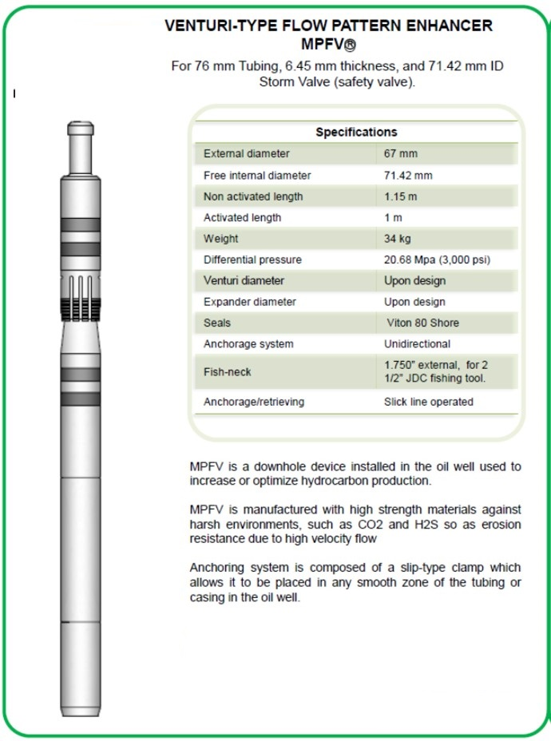
Background
The Flow Pattern Enhancer MPFV® is a mechanical system, created for downhole applications, it is made with corrosion-resistant materials and its main components are erosion-resistant.
The MPFV® have 3 main components engineered to specific conditions of each well
Primary Expander is designed to controlling the pressure and flow of hydrocarbons coming from reservoir,
Venturi Neck generates a homogeneous flow and prevents slippage of gas and liquid in well tubing, both parts, Venturi Neck and Primary Expander, are coupled to retrievable packer,
Retrievable Packer fixes hermetically entire system against production tubing.

Slide 4
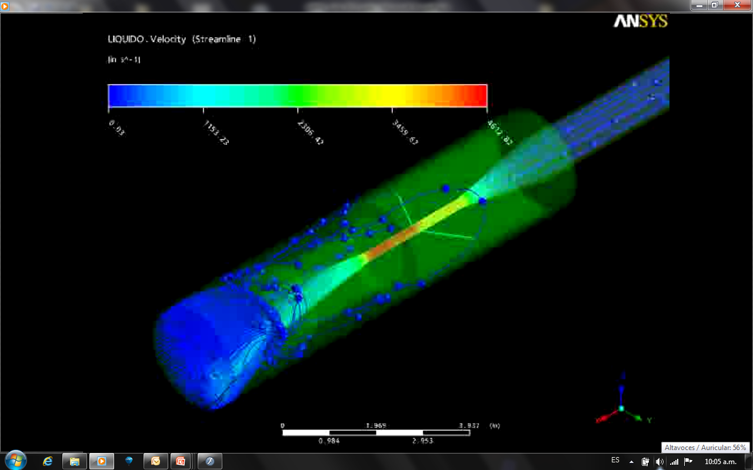

Theoretical Foundation
The Venturi-type flow pattern enhancer system MPFV®
  The MPFV®’s operation is like the jet effect in a hydraulic pump, velocity of flow increases inversely proportional to pressure in the Venturi’s neck troth. The reservoir´s fluid is the only source of energy and flows through the MPFV® like power fluid in a Jet pump, that is why MPFV® is not consider a production artificial system.
  The Venturi effect can be calculated by combining the Bernoulli’s principle and the continuity equation.

Slide 5
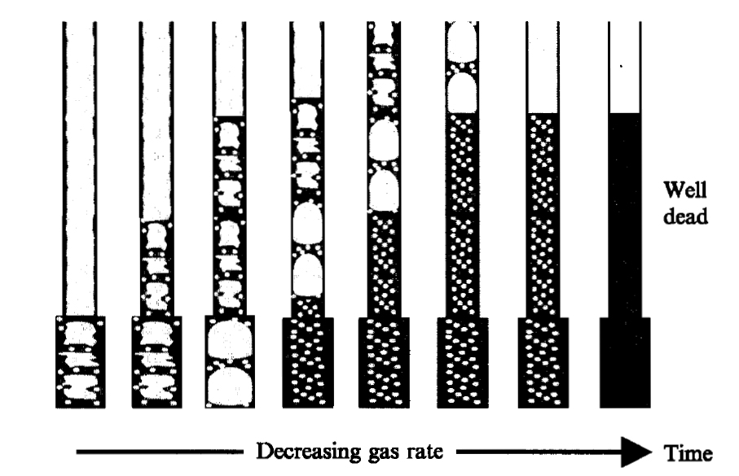
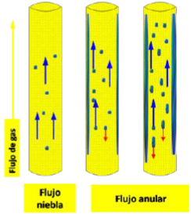
Liquid Loading
  In mature gas fields Intermittent flow patterns are presented by a periodic flow of gas and liquid with a large variation of flow rate and pressure into the well tubing, this instability generates unexpected interruptions in well production.
Liquid loading
Homogeneous Flow
Liquid film
The appropriate selection of Venturi system would help to hydrocarbon flow, decreasing the energy losses by the intermittent flow pattern, accelerating and mixing the gas and liquid phases, with a lower energy requirement.
Gas flow
Mist
Flow
Annular Flow

Slide 6
Tubing Energy Management
MPFV® is used in wells to:
Increase flow velocity avoiding slippage of gas and liquid phases.
Mixes two or more phases in homogeneous flow.
Reduces pressure drops in the production tubing.
Avoids liquids accumulation in the bottomhole.
No more freezing piping's and Methane Hydrates formation in the surface.

Slide 7
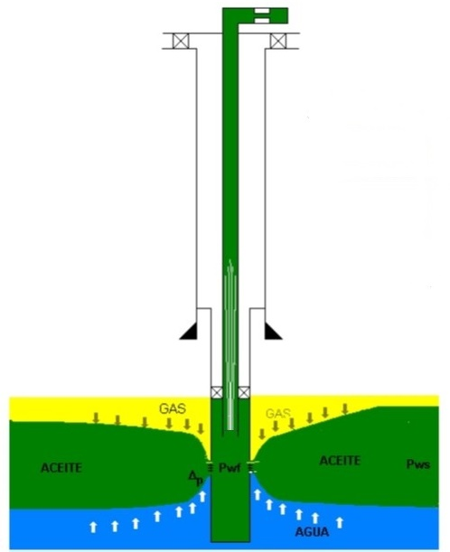

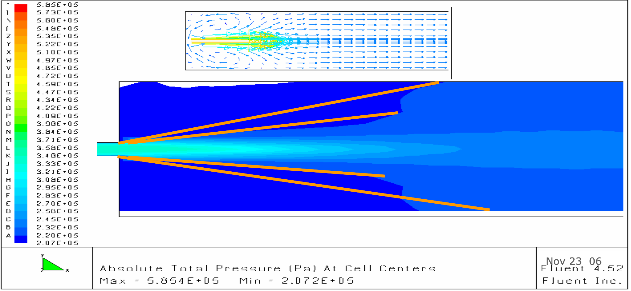

Tubing Energy Management
WELL
SLUG
MIST
UNSTABLE FLOW WITH LIQUID LOADING
HOMOGENEOUS FLOW WITHOUT LIQUID LOADING
NO MPFV®
WITH MPFV®
HIGH VELOCITY ZONE
MPFV®
TURBULENT FLOW
SMOOTH FLOW

Slide 8
Reservoir Energy Management
Reduces the effects of turbulent flow in porous media such as:
High pressure drops in the porous media.
Separation and segregation of the gas and liquid phases.
Conification of water.
Gas condensation in a porous media, blocking the flow to well.
Solids Production

Slide 9



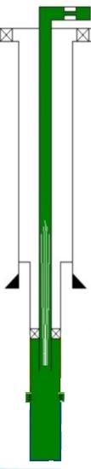




Reservoir Energy Management
RESERVOIR
WITHOUT MPFV®
WITH MPFV®
TURBULENT OR CHAOTIC FLOW AFFECTS
DROP OF PRESSURE AND INCREASES THE RESERVOIR DECLINATION.

Slide 10
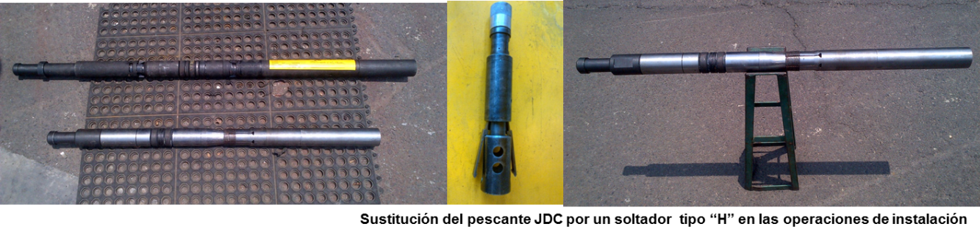
Uses
  MPFV® has been installed on 700 wells of several fields of PEMEX.
IMP has given this service to Pemex since 2009 in the Northern and Southern regions.
The tool is manufactured for standard tubing sizes as 2 7/8”, 3 ½” and 4 ½” nominal diameter.
The MPFV® Service includes wells simulation, design, manufacturing, installation and maintenance.
MPFV® is installed and retrieved of production tubing just with help of a slickline unit with standard accessories.

Slide 11
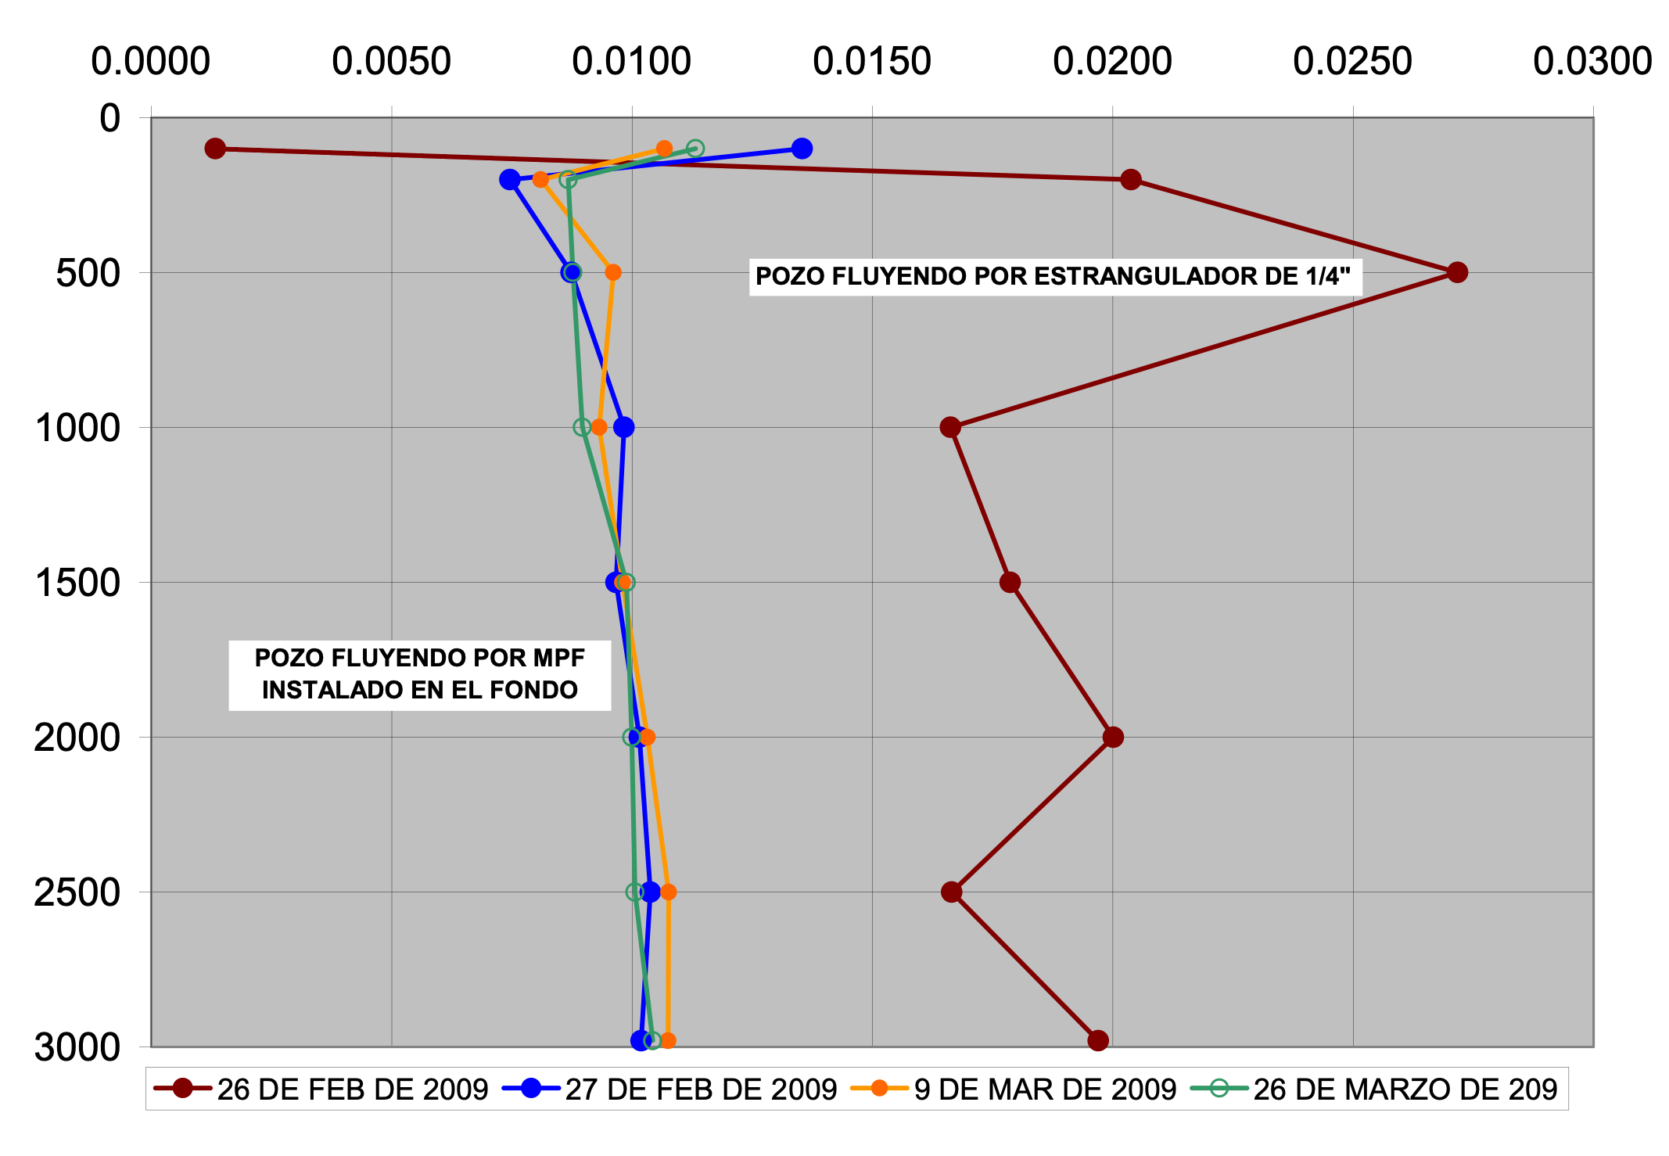
Oil and Gas Wells
GOALS:
Homogeneous flow with reduction of pressure drop in the production tubing.
PRESSURE GRADIENT (Kg/cm2 m)
WELL “A”
NO MPFV®
The pressure gradient produced after installation of the MPFV® was more stable than before, this indicates that flow pattern was improved, reducing pressure losses in well.
MESUERE DEPTH (METERS)
WITH MPFV®

Slide 12
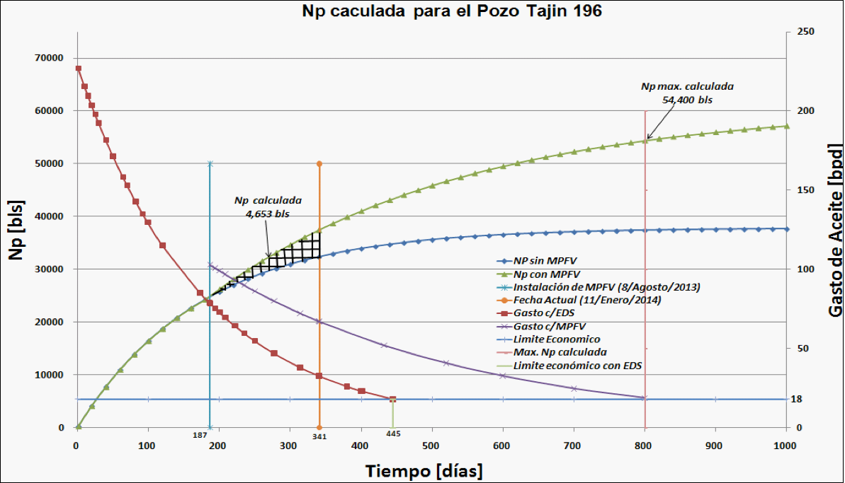
Unconventional Oil reservoirs
GOALS:
Increase Oil Net Production (Np).
WELL “B”
WITHOUT MPFV®
WITH MPFV®
The MPFV® applied in unconventional reservoirs for production maintenance.
The MPFV® changed the decline trend of production.
The MPFV® increased recovered production by 4,653 barrels in 154 days.
Increases the productive life of the well
WITHOUT MPFV®
Oil flowrate (BPD)
WITH MPFV®
Marginal Flowrate
Time (Days)

Slide 13
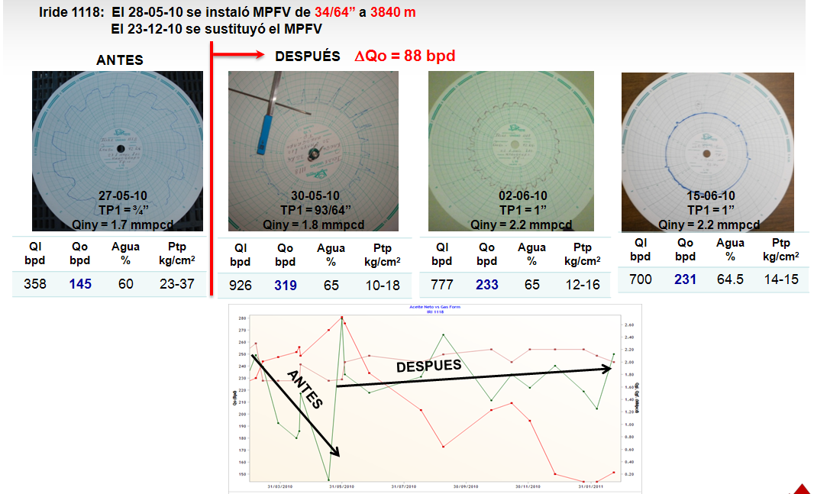
Water Control
With MPFV® since
Depth of installation
Well head pressure Charts
WITHOUT MPFV®
WITH MPFV®
Water
%
Water
%
Water
%
Water
%
The MPFV® applied in oil reservoirs for control of water production and stabilization of well head pressure.
A wide variation in well head pressure is identified, from 23 to 37 kg / cm², with a water cut of 60%.
The MPFV system stabilized pressure from 14 to 15 kg/cm² and increased net oil production from 145 to 230 bpd.
WITH MPFV®
WITHOUT MPFV®

Slide 14
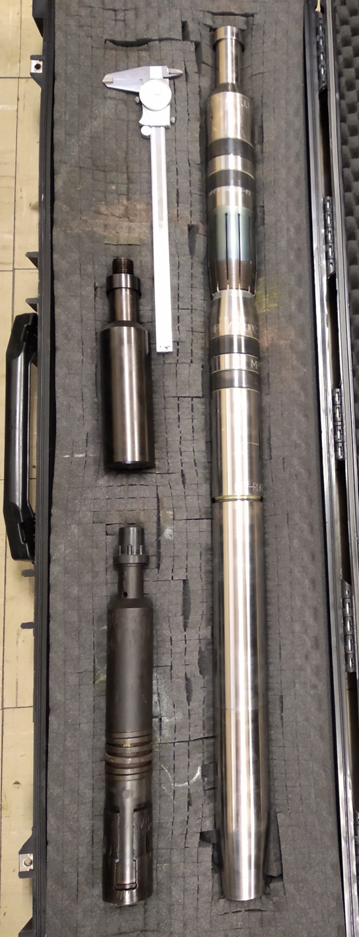
Gas Wells - Analysis
Gas wells (10) from the Northern Region in the Burgos Basin have been selected for an economic analysis with the MPFV®.
Well | Set-up date | Ø Venturi y Exp. (in) | Depth (m)
1A | 06/11/2009 | 18x20 | 1911
1B | 29/11/2009 | 16x18 | 2006
1C | 24/12/2009 | 12x14 | 2208
1D | 27/01/2010 | 14x16 | 1946
1E | 18/02/2010 | 20x22 | 2317
1F | 21/02/2010 | 18x20 | 1800
1G | 29/03/2010 | 10x12 | 3178
1H | 22/04/2010 | 10x12 | 2762
1I | 23/07/2010 | 12x14 | 1680
1J | 09/09/2010 | 14x16 | 2383

Slide 15
Gas Wells – Economic Analysis
An average of 24 months of production was considered for the analysis with the MPFV®.
Well | Gp Increase (mmcf) | IPV (MUSD) | NPV (MUSD) | NPV/IPV (MUSD)
1A | 597 | 295 | 1,207 | 4.09
1B | 867 | 414 | 1,761 | 4.25
1C | 97 | 74 | 175 | 2.37
1D | 560 | 721 | 3,189 | 4.42
1E | 923 | 440 | 1,880 | 4.27
1F | 299 | 164 | 594 | 3.62
1G | 318 | 174 | 639 | 3.68
1H | 182 | 111 | 346 | 3.13
1I | 171 | 106 | 324 | 3.06
1J | 437 | 225 | 877 | 3.90
Mean | 445 | 272 | 1,099 | 3.68

Slide 16

Performance production Well 1G

